Slide 1
CS7712 - SECURITY LABORATORY
Mini Project

Slide 2
Real Time Filtering of Malicious URLS
Ishwarya S - 2017103537
Harshini T - 2017103532
Gokul K - 2017103526

Slide 3
Introduction
The rapid development of communication technologies and broadband speeds has greatly democratized the internet. The number of internet users has grown exponentially in the past few years. This has caused a sharp increase in the global internet traffic.
This has also opened up several avenues for online fraud. There are several malicious URLs on the internet that are used to scam and cheat people. In many cases privacy of the person is violated and this can also lead to money thefts. Therefore it is of great importance to filter the malicious URLs on the internet. But this process is a bottleneck because of the high internet traffic. Hence it is essential to develop a lightweight filtering system to filter out the harmful URLs.

Slide 4
Abstract
In this project we aim to develop a robust and scalable classifier that can perform URL filtering in real-time using lightweight features so that this reduces the processing pressure of the back-end malicious URL detection systems based on content analysis.
We will be exploring 3 different algorithms for this classifier and provide a comparative study on the performance of the algorithms using Precision, Recall and Accuracy metrics. The different URL features like URL Length, number of special characters in the URL, origin server, origin country, charset, content length, registration date of the website, last modified date have been used for the classification process. This will be performed as a binary classification problem.

Slide 5
Objective
The main aim of the project is to build a lightweight filtering system to filter out the malicious URLs by using Machine Learning Algorithms and methodologies. This process should be lightweight so that the browsing experience of the user is affected.

Slide 6
Algorithms
Three Machine Learning Algorithms have been used for this project
Multi-Layer Perceptron
Random Forest Classifier
Support Vector Machine
Language and Frameworks:
The project was built using the Python programming language. Frameworks like Scikit-Learn, Tensorflow, Keras, Numpy and Pandas were used for this project.

Slide 7
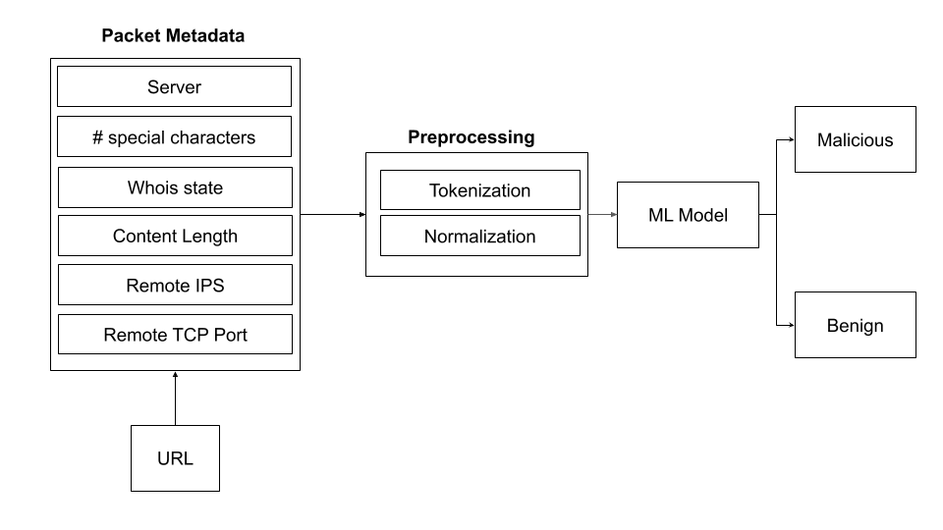
System Architecture

Slide 8
Modules
Pre-processing
2. Model Building
2.1 Multi Layer Perceptron
2.2 Random Forest
2.3 Support Vector Machine
2.4 Final Comparison Results
3. Real Time Filtering Outputs

Slide 9
Module 1 : Pre-processing
1. Feature Selection: Only 6 features were selected for the training of the models. These features were selected based on the covariance value with the output label.
#selecting particular columns
df_part= df[['NUMBER_SPECIAL_CHARACTERS','SERVER','CONTENT_LENGTH','WHOIS_STATEPRO','DIST_REMOTE_TCP_PORT','REMOTE_IPS','Type' ]]
2. Tokenization: Converting the strings to numeric tokens.
#mapping the strings to integers or tokens
server_names = df.SERVER.unique()
server_names_map = {k:v for v,k in enumerate(server_names)}
state_names = df.WHOIS_STATEPRO.unique()
state_names_map = {k:v for v,k in enumerate(state_names)}
Feature Selection :
Tokenization :
Normalization :
#making the NaN values as 0
df_part['CONTENT_LENGTH'] = df_part['CONTENT_LENGTH'].fillna(0)
#making the content_length column as type int
df_part['CONTENT_LENGTH'] = df_part['CONTENT_LENGTH'].astype('int')

Slide 10
Pre-processing
3. Normalization:
Since the range of the numeric data is very large, the variance increases and this affects the training process. To reduce variance, Normalization is done.
#making the NaN values as 0
df_part['CONTENT_LENGTH'] = df_part['CONTENT_LENGTH'].fillna(0)
#making the content_length column as type int
df_part['CONTENT_LENGTH'] = df_part['CONTENT_LENGTH'].astype('int')

Slide 11
Module 2 : Model Building
Three Machine Learning Algorithms have been used for this project
Multi-Layer Perceptron
Random Forest Classifier
Support Vector Machine

Slide 12
MLP : Code
A Multi-Layer Perceptron (MLP) or Multi-Layer Neural Network contains one or more hidden layers (apart from one input and one output layer). While a single layer perceptron can only learn linear functions, a multi-layer perceptron can also learn non – linear functions.
model = tf.keras.models.Sequential()
model.add(tf.keras.layers.Dense(10, activation='relu'))
model.add(tf.keras.layers.Dense(16, activation='relu'))
model.add(tf.keras.layers.Dense(32, activation='relu'))
model.add(tf.keras.layers.Dense(1, activation='sigmoid'))
adam_optimizer = tf.keras.optimizers.Adam(learning_rate=0.001)
model.compile(optimizer=adam_optimizer, loss='binary_crossentropy', metrics=['accuracy'])

Slide 13
MLP : Code
history = model.fit(X_train, y_train, batch_size=32, epochs=30, verbose=1, validation_split=0.1, shuffle=True)
Epoch 27/30
41/41 [==============================] - 0s 2ms/step - loss: 0.1471 - accuracy: 0.9368 - val_loss: 0.1849 - val_accuracy: 0.9021
Epoch 28/30
41/41 [==============================] - 0s 1ms/step - loss: 0.1461 - accuracy: 0.9368 - val_loss: 0.1834 - val_accuracy: 0.9021
Epoch 29/30
41/41 [==============================] - 0s 2ms/step - loss: 0.1455 - accuracy: 0.9375 - val_loss: 0.1849 - val_accuracy: 0.9021
Epoch 30/30
41/41 [==============================] - 0s 2ms/step - loss: 0.1444 - accuracy: 0.9360 - val_loss: 0.1840 - val_accuracy: 0.9021

Slide 14
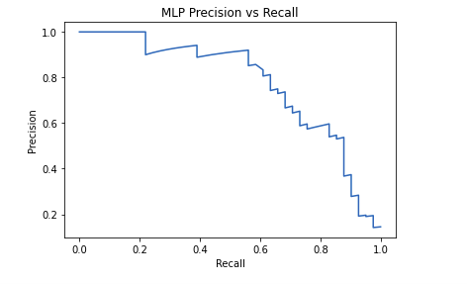
MLP : Evaluation metrics
Results:
Precision-Recall graph:
class | precision | recall | F1 - Score
0 | 0.96 | 0.97 | 0.96
1 | 0.73 | 0.66 | 0.69
Accuracy = 93%

Slide 15
Random Forest : Code
Random forest is a supervised learning algorithm which is used for both classification as well as regression. It creates decision trees on data samples and then gets the prediction from each of them and finally selects the best solution by means of voting. It is an ensemble method which is better than a single decision tree because it reduces the over-fitting by averaging the result.
from sklearn.ensemble import RandomForestClassifier
classifier = RandomForestClassifier(n_estimators=30, random_state=42)
classifier.fit(X_train, y_train)
y_pred = classifier.predict(X_test)
from sklearn.metrics import classification_report, confusion_matrix, accuracy_score
print(confusion_matrix(y_test,y_pred))
print(classification_report(y_test,y_pred))
print(accuracy_score(y_test, y_pred))

Slide 16
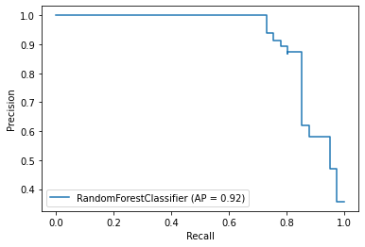
Random Forest : Evaluation metrics
Precision-Recall graph:
Result:
Class | Precision | Recall | F1 - Score
0 | 0.97 | 0.99 | 0.98
1 | 0.89 | 0.80 | 0.85
Accuracy = 96%

Slide 17
SVM : Code
Support Vector Machine is a supervised learning algorithm which is used for both classification as well as regression. Basically, SVM finds a hyper-plane that creates a boundary between the types of data. In 2-dimensional space, this hyper-plane is nothing but a line.
In SVM, we plot each data item in the dataset in an N-dimensional space, where N is the number of features/attributes in the data. Next, find the optimal hyperplane to separate the data.SVM can only perform binary classification (i.e., choose between two classes).
SVM :
clf = svm.SVC(kernel='rbf')
clf.fit(X_train, y_train)
Constraints:
SVC(C=1.0, break_ties=False, cache_size=200, class_weight=None, coef0=0.0,
decision_function_shape='ovr', degree=3, gamma='scale', kernel='rbf',
max_iter=-1, probability=False, random_state=None, shrinking=True,
tol=0.001, verbose=False)

Slide 18
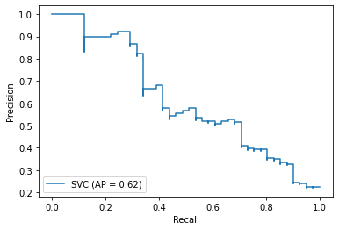
SVM : Evaluation metrics
Result:
Precision-Recall graph:
Class | Precision | Recall | F1 - Score
0 | 0.92 | 1 | 0.95
1 | 0.92 | 0.29 | 0.44
Accuracy : 92%

Slide 19
Final Comparison Results
Model | Accuracy | Precision
Multi Layer Perceptron | 92.4% | 96%
Random Forest | 96.6% | 97%
SVM | 91.6% | 92%

Slide 20
Module 3 : Real Time Filtering
def pred_link(server = "None", whois_state="None",
nos_spl_chars = 0, content_len = 0,
remote_ips = 0, remote_tcp=0):
server_token = server_names_map[server]
whois_state_token = state_names_map[whois_state]
inp_arr = [[nos_spl_chars, server_token, content_len,
whois_state_token, remote_tcp, remote_ips]]
inp_arr = sc.transform(inp_arr)
result = classifier.predict(inp_arr)
if result == 0:
return "The link is not safe"
return "The link is safe"

Slide 21
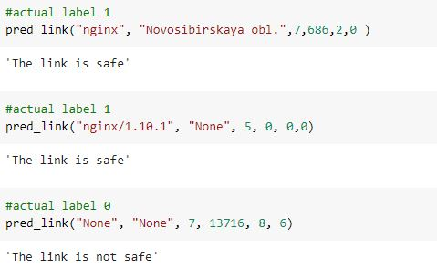
Output Screenshot

Slide 22
Conclusion
Thus through this project we conclude that the Random Forest Classifier is best suited for the real-time filtering of the malicious URLs.
It is fast and also accurate compared to the MLP and SVM models.

Slide 23
References
1. Research paper:
https://ieeexplore.ieee.org/document/8672274
2. Dataset:
https://www.kaggle.com/xwolf12/malicious-and-benign-websites
3. Random Forest:
https://www.tutorialspoint.com/machine_learning_with_python/machine_learning_with_python_classification_algorithms_random_forest.htm
4. Multi Layer Perceptron:
https://medium.com/@AI_with_Kain/understanding-of-multilayer-perceptron-mlp-8f179c4a135f
5. Support Vector Machine:
https://towardsdatascience.com/support-vector-machine-introduction-to-machine-learning-algorithms-934a444fca47
6. Model:
https://towardsdatascience.com/machine-learning-general-process-8f1b510bd8af

Slide 24
Thank You !

